Slide 1

CUSTOMER ACQUISITION ANALYSIS Prepared by: Dax Patel

Slide 2
STPES IN ANALYSIS
Requirement Gathering
Stakeholders in the Project
Raw Data Overview
Data exploration and cleaning
Connecting Data with Power BI
Data processing in Power Query
Data Modelling
Background preparation
Data Visualization/ chart design
Dashboard building
Insights gathering

Slide 3
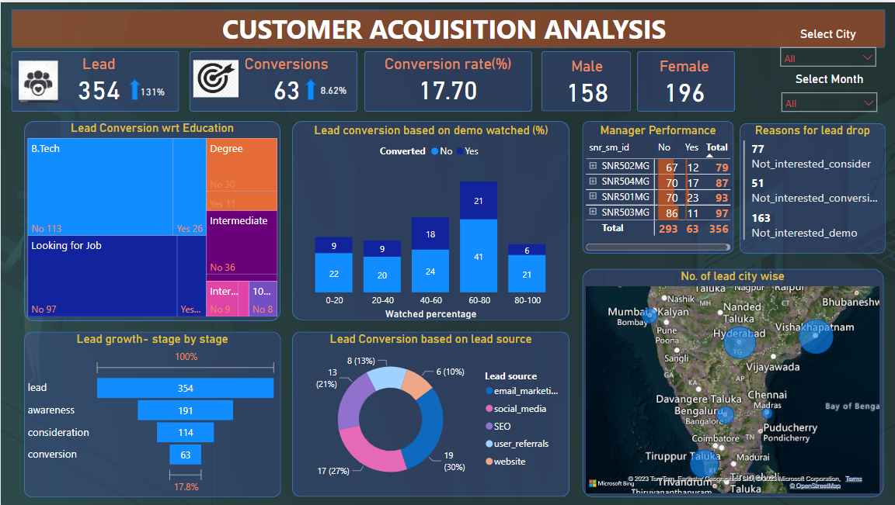
FINAL DASHBOARD

Slide 4
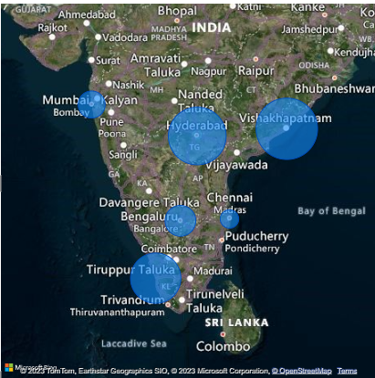
INSIGHTS DISCUSSIONS
Maximum no. of leads reported in Vishakhapatnam. And minimum no. of leads reported in Chennai.
From this map company can find out cities with lower lead acquisitions.
So that company should have to developed targeted marketing efforts to boost engagement in those area.
Number of lead city wise

Slide 5
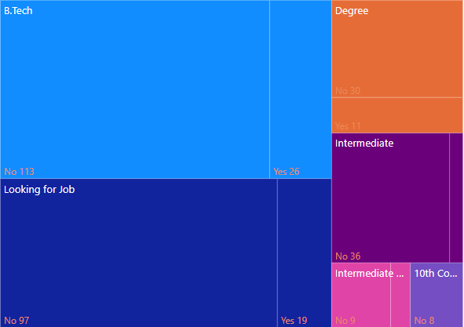
Highest number of leads and conversions are shown in leads with B.Tech educational background and Lead who are looking for job.
So company have to allocate more resources to target that segments for more conversion potential
Lead conversion based on educational background

Slide 6
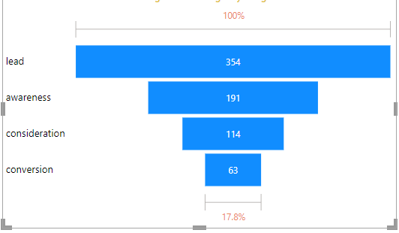
This funnel diagram shows conversion rate between each stage.
We can observed significant drop off in lead to awareness stage.
So company should have to focus on this stage in terms of better engagement, strategy and users experience.
Lead progression on each stage

Slide 7
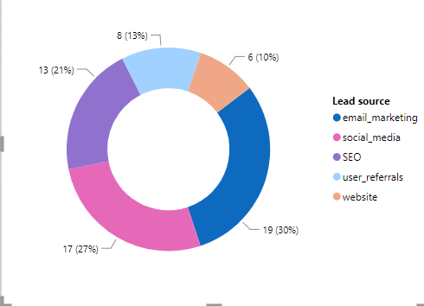
We can identify which lead sources contribute the most and least to conversions. This insight helps you allocate resources and focus on the most effective channels.
Company should have to identify potential reasons where conversion rate are lower for certain lead sources.
Conversion based on lead source

Slide 8
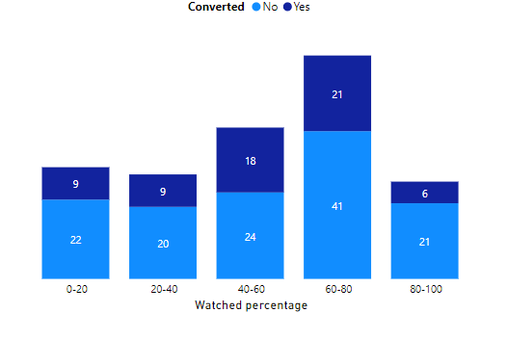
This bar graph shows the number of leads and conversion w.r.t demo watched percentage.
Maximum number of leads have watched 40-80 % demo, But Conversion rate is not up to the mark.
No. of leads and conversion based on demo watched %

Slide 9
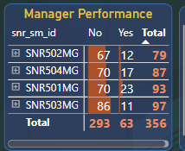
We can identify top performing managers for higher conversion rates.
So company can allocate resources and support to managers who might need assistance in specific areas.
So Stakeholders can set performance improvement goals for managers based on the insights from the matrix table and monitor progress over time.
Manager Performance

Slide 10
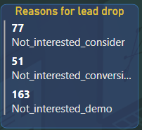
As per data out of 291 lead drop, majority leads have mention Not interested in demo as a reason of being drop.
So Business people must have find potential gap in demo and plan accordingly.
Lead drop reasons

Slide 11


